Slide 1
Docker Deep Dive and Intro to Kubernetes

Slide 2
DSE on Docker History
Fall of 2015
November 16th , 2017
April 17th, 2018
December 5th, 2018
Release Production Support for customer built images with DSE 4.8
Soft Launch of DSE Images
Official Launch of Development Images
Production Support for Docker Images
Notes:
So lets start this from the beginning
With 4.8 we announced production support for customer built Images
11/17 - soft launch of DataStax development images
4/18 - official launch of development images and Public Github Repo
12/18 - Production ready Images
Why are we Now releasing these for Production? The images have been battle tested in the field, inhouse and have proven themselves to be production ready

Slide 3
DSE Docker Images Documentation
Here are Places to get documentation and help with the DataStax Images
Datastax documentation
https://docs.datastax.com/en/docker/doc/index.html
Readme in github
https://github.com/datastax/dockerimages
Internal Docs
https://datastax.jira.com/wiki/spaces/KB/pages/609189889/Getting+Started+with+DataStax+Docker+Images
Internal Slack Room
#docker
Docker Hub
https://cloud.docker.com/u/datastax/repository/list

Slide 4
Docker Cheat Sheet
Get IP Address of container - docker inspect <container_name or id> | grep IPAddress
Get a bash shell - docker exec -it <container_name or id> bash
Get a shell as root - docker exec -it --user root <container_name or id> bash
Get a cql shell - docker exec -it <container_name or id> cqlsh
Get a Gremlin console - docker exec -it <container_name or id> dse gremlin-console
Stop a container - docker stop <container_name or id>
Start a stopped container - docker start <container_name or id>
Remove a container and blow away it's state - docker rm <container_name or id>
Remove an image from the system - docker rmi image_id
Remove stale volumes left behind by removed containers - docker volume prune
Gives you information on your running containers - docker container stats
Get container/image config details - docker inspect <identifier>
Rename container - docker rename
Changing a running containers configuration - docker update

Slide 5
Exercise 1 Install Docker
You should already have a c3.2xlarge: (8vcpu, 16384ram, 80gb) instance running Ubuntu 16.04 in openstack. This will allow us to run at least 4 containers containers
Verify swap is disabled on your Host
Install Docker for your OS
Check your disk usage.

Slide 6
Exercise 2 Basics
Create a transactional workload DSE container using instructions found here
docker run -e DS_LICENSE=accept --name my-dse -d datastax/dse-server
Stop, start and restart the container (docker stop <container_name>, docker start <container_name> and docker restart <container_name>)

Slide 7
Exercise 3 Intro to Troubleshooting and Resource Management
Create a transactional workload DSE container limiting the ram available to the container to 4GB with the docker run flag -m 4g. Did the container start?
Did the container stay running? Check with docker ps -a
If it exited why? Check docker logs <container_name> and docker inspect <container_name> for the reason why it exited
Use docker inspect <container_name> to find volume information, ip address, ports, java, Env information.
Notes:
docker run -e DS_LICENSE=accept -m 4g --name my-dse -d datastax/dse-server

Slide 8
Exercise 3 continued
Create a new transactional workload DSE container limiting the ram available to the container to 12GB with the docker run flag -m 12g.
For the new container run docker exec -it <container_name> free -m
Does anything seem odd since you limited the ram to 12gb?
What other Hardware resources can you limit?
Use docker stats to see resources being utilized by your containers.
Notes:
docker run -e DS_LICENSE=accept -m 12g --name my-dse -d datastax/dse-server
docker exec -it my-dse free -m

Slide 9
Exercise 3: Conclusion
When container is run with limited RAM, the standard system API used by the JVM for probing, will return host-wide values.
When using OpenJDK 8 you should explicitly set the heap with the environmental variable JVM_EXTRA_OPTS. For example to set a 2GB heap add this to your docker run command
-e JVM_EXTRA_OPTS="-Xms2g -Xmx2g"
Beginning with OpenJDK 8_u171 there are experimental features to enable the detection of container-limited amounts of RAM by using the following options.
java -XX:+UnlockExperimentalVMOptions -XX:+UseCGroupMemoryLimitForHeap
Notes:
To limit heap to 2 GB
docker run -e DS_LICENSE=accept -e JVM_EXTRA_OPTS="-Xms2g -Xmx2g" --name my-dse -d datastax/dse-server This will append -Xms2g -Xmx2g

Slide 10
Exercise 4: Kill and Remove
Kill and destroy your previous containers
See if you can find a way to kill and remove all of you container at once
Check your disk usage. Wow even though the containers are gone, they are taking up disk space
Figure out how to free up space the removed containers left behind
Notes:
docker kill $(docker ps -a -q) will kill all running containers
docker rm $(docker ps -a -q) will stop all running containers
docker container prune

Slide 11
Exercise 5: Advanced configuration and Persisting Data
Create a Docker User-defined network
Create a 3 container cluster with 2 DSE containers and 1 Opscenter container with the below configurations. Be sure to use --network=<user-defined-network> in your docker run command so they are all in the same network.
Create Opscenter container first (there is a script in the DSE entrypoint that checks for an opscenter container that configures and starts the datastax-agents in your DSE containers) and make sure to publish port 8888
Create 2 DSE containers specifying the seed node with the SEEDS env and mounting your data volumes and config volumes (Hint you will need separate directories on your host for each container)
Add your cluster to opscenter
Notes:
docker network create mynetwork
docker run -e DS_LICENSE=accept --network=mynetwork --name my-opscenter -d -p 8888:8888 datastax/dse-opscenter
docker run -e DS_LICENSE=accept --network=mynetwork --link my-opscenter:opscenter -v /home/my-dse/config:/config -v /home/my-dse/data:/var/lib/cassandra --name my-dse -d datastax/dse-server
docker run -e DS_LICENSE=accept --network=mynetwork --link my-opscenter:opscenter --link my-dse:dse --SEEDS=dse -v /home/my-dse2/config:/config -v /home/my-dse2/data:/var/lib/cassandra --name my-dse2 -d datastax/dse-server
To get the ipaddress
docker inspect <container_name or id> | grep IPAddress
open a browser to dockerhostip:8888
add using the ipaddress from previous
don’t forget the agent is already installed

Slide 12
Exercise 5 continued
Copy your dse.yaml from each of the DSE containers to your host
Modify the copied dse.yaml to enable DSE advanced security using internal auth and place them into the exposed /config volume you mounted earlier for each container and restart your containers
Did your container start? If not figure out why. Is internal auth enabled? Check by getting a cqlsh prompt using docker exec
Create a keyspace, table and add some data
Notes:
Use docker cp to copy the dse.yaml to the host
Modify the yaml to enable internal auth following https://docs.datastax.com/en/dse/6.7/dse-admin/datastax_enterprise/security/Auth/secEnableDseAuthenticator.html
Add you modified dse.yaml to the /config volume.
docker restart both dse containers
after you verify auth is enabled
modify dse.yaml to disable auth and restart your dse containers

Slide 13
Exercise 5 continued
Create a keyspace, table and add some data
Create directory for the demo data docker exec -it my-dse mkdir /opt/dse/demodata
Download the script to create the keyspace, table and load the data docker exec -it my-dse wget -L https://raw.githubusercontent.com/roberd13/tableau-dse6-demo/master/DemoData/cqlscript.sh -O /opt/dse/demodata/cqlscript.sh
Change the permissions to allow execution of the script docker exec -it my-dse chmod +x /opt/dse/demodata/cqlscript.sh

Slide 14
Exercise 5 continued
Download the demo data docker exec -it my-dse wget -L https://raw.githubusercontent.com/roberd13/tableau-dse6-demo/master/DemoData/videos.csv -O /opt/dse/demodata/videos.csv docker exec -it my-dse wget -L https://raw.githubusercontent.com/roberd13/tableau-dse6-demo/master/DemoData/videos_by_actor.csv -O /opt/dse/demodata/videos_by_actor.csv
Run the cqlscript.sh script to create keyspace, tables and load the data using the dsebulk tool. A Keyspace named killr_video with 2 tables videos and videos_by_actor will be created.
docker exec -it my-dse bash "/opt/dse/demodata/cqlscript.sh"
Run nodetool flush on each node using docker exec

Slide 15
Exercise 6: Persistence
Kill and remove the containers
Check the data directories you created on the host. Does data from the containers still exist?
Create 2 new DSE containers mounting the volumes you did previously containing the data you created.
Did the containers start? If not figure out why
Use cqlsh to see if the data is still there
Kill and remove the containers along with the volumes
Notes:
After removing your containers start new container mounting the same volumes
docker run -e DS_LICENSE=accept --network=mynetwork -v /home/my-dse/config:/config -v /home/my-dse/data:/var/lib/cassandra --name my-dse -d datastax/dse-server
docker run -e DS_LICENSE=accept --network=mynetwork --link my-dse:dse -v /home/my-dse2/config:/config -v /home/my-dse2/data:/var/lib/cassandra --name my-dse2 -d datastax/dse-server

Slide 16
Exercise 7 Multiple hosts
Install WeaveNet Docker Plugin on each host
Create a 2 node cluster by starting a container on each host using the SEED env and weave network
Verify the nodes are clustered with nodetool status on each node
Notes:
Once you kill and remove the weavenet plugin containers dont forget to run
unset DOCKER_HOST

Slide 17
Exercise 8: Time to Build
Download the datastax/docker-images github repo to your
instance
wget -L https://github.com/datastax/docker-images/archive/master.zip -O master.zip

Slide 18
Exercise 8: Continued
Build the images using these instructions
Start an opscenter container using the image you built
Start a DSE container Using the image you built and linking the Opscenter container
Add your DSE node to Opscenter
Notes:
docker run -e DS_LICENSE=accept --name my-opscenter -d -p 8888:8888 datastax/dse-opscenter
docker run -e DS_LICENSE=accept --link my-opscenter:opscenter --name my-dse -d datastax/dse-server

Slide 19
Exercise 9: Create Seperate DC
Using your DSE image created in exercise 9 start a new DSE container using the DC environment variable to create a separate DC. Also don’t forget to pass the SEEDS environment variable
Notes:
docker run -e DS_LICENSE=accept -e DC=mydc --link my-opscenter:opscenter --link my-dse:dse -e SEEDS=dse --name my-dse2 -d datastax/dse-server

Slide 20
Exercise 10: HomeWork Born to Be Wild
Write your own Docker file and entrypoint.sh to build any version of DSE you would like
Use docker build to build your image
Start a container using your image
You can use this white paper for a reference. http://www.datastax.com/wp-content/uploads/resources/DataStax-WP-Best_Practices_Running_DSE_Within_Docker.pdf

Slide 21
Intro to Orchestration with Kubernetes

Slide 22
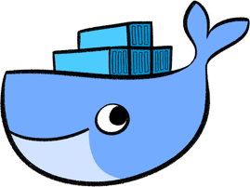
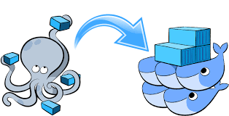
Docker Compose with Docker Swarm
Notes:
Here we have the
containers doing a bunch of random whatever
compose is like the foreman that pops alot of speed to stay going
swarm does the cool stuff in clustering and discovery

Slide 23
Exercise 1 Use Compose to easily create a cluster
Install Docker compose on your Host
Using the instructions found here. Modify the compose.yaml to change the cluster_name to Spicy_Sandwich and Start a 3 node cluster with docker compose
Verify the cluster name was changed using nodetool describecluster
Once you have verified the cluster is running with the name Spicy_Sandwich kill and remove it.

Slide 24
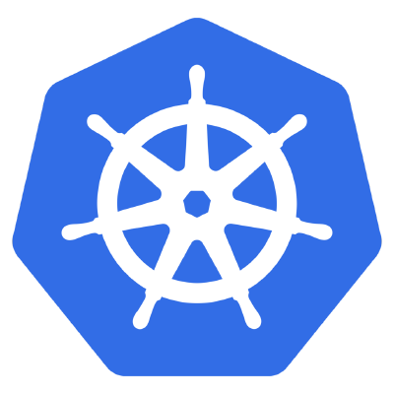
Kubernetes
Notes:
Kubernetes is a container orchestration platform gaining lots of popularity due to its simplicity. Kubernetes is great as you can define your deployment configuration, storage, and network using config files and the cluster will ensure your application is always running in that configuration.
Kubernetes, at its basic level, is a system for running and coordinating containerized applications across a cluster of machines. It is a platform designed to completely manage the life cycle of containerized applications and services using methods that provide predictability, scalability, and high availability.
Kubernetes (K8s) is a portable, extensible open-source platform for managing containerized workloads and services, that facilitates both declarative configuration and automation.
Kubernetes provides a container-centric management environment that allows operators to declare an operating state of an application for K8s to maintain
It was open sourced to the Cloud Native Computing Foundation in 2016 as an implementation

Slide 25

Kubernetes Hype
Notes:
Many organizations are considering the development of new modern applications with distributed scalable backends, this includes automated management of operational tasks, failover scenarios, and discovery of services within the enterprise. These organizations are drawn to the allure and promises of Kubernetes to modernize and move to a more containerized and microservices based Infrastructure.
We have customers that are running DSE on Kubernetes now
Macquarie Bank
American Airlines
ING
Cerner
Proximus ESRI
Apple Just to name a few

Slide 26
Why Kubernetes
Reproducibility
Immutability
Easier deployment
Networking abstraction

Slide 27
What Exists Today at DataStax
GKE offering: Dev Env Only
https://console.cloud.google.com/marketplace/details/datastax-public/datastax-enterprise-gke
Field Partner Repos: Dev Env Only
https://github.com/DSPN/kubernetes-dse
https://github.com/DSPN/kubernetes-dse-gke
https://github.com/DSPN/gke-marketplace-dse
DSE Desktop: *POC* An electron based desktop client using K8s as the orchestrator
https://github.com/riptano/dse-desktop
CTOOL K8s Cluster Deployment: Thanks to Alex Ott
https://github.com/riptano/alexott-internal-work/tree/master/k8s-scripts

Slide 28
Installing Kubectl
Install Kubectl
sudo apt-get update && sudo apt-get install -y apt-transport-https
curl -s https://packages.cloud.google.com/apt/doc/apt-key.gpg | sudo apt-key add -
echo "deb https://apt.kubernetes.io/ kubernetes-xenial main" | sudo tee -a /etc/apt/sources.list.d/kubernetes.list
sudo apt-get update
sudo apt-get install -y kubectl
kubectl version

Slide 29
Installing Kubectl continued
Append the following line to ~/.bashrc to enable kubectl command auto-completion
echo "source <(kubectl completion bash)">> ~/.bashrc
Source your ~/.bashrc to pick up the changes
source ~/.bashrc

Slide 30
Installing MiniKube
Install Minikube by downloading the binary:
curl -Lo minikube https://storage.googleapis.com/minikube/releases/latest/minikube-linux-amd64 \ && chmod +x minikube
Add the Minikube executable to your path:
cp minikube /usr/local/bin && rm minikube
Start MiniKube
minikube start --vm-driver=none

Slide 31
Getting to know your Cluster
Below are a few commands to help you get to know your Cluster
kubectl get node kubectl get secret kubectl config view kubectl config current-context kubectl get componentstatus kubectl get clusterrolebinding --all-namespaces kubectl get serviceaccounts --all-namespaces kubectl get pods --all-namespaces -o wide kubectl get services --all-namespaces -o wide kubectl cluster-info

Slide 32
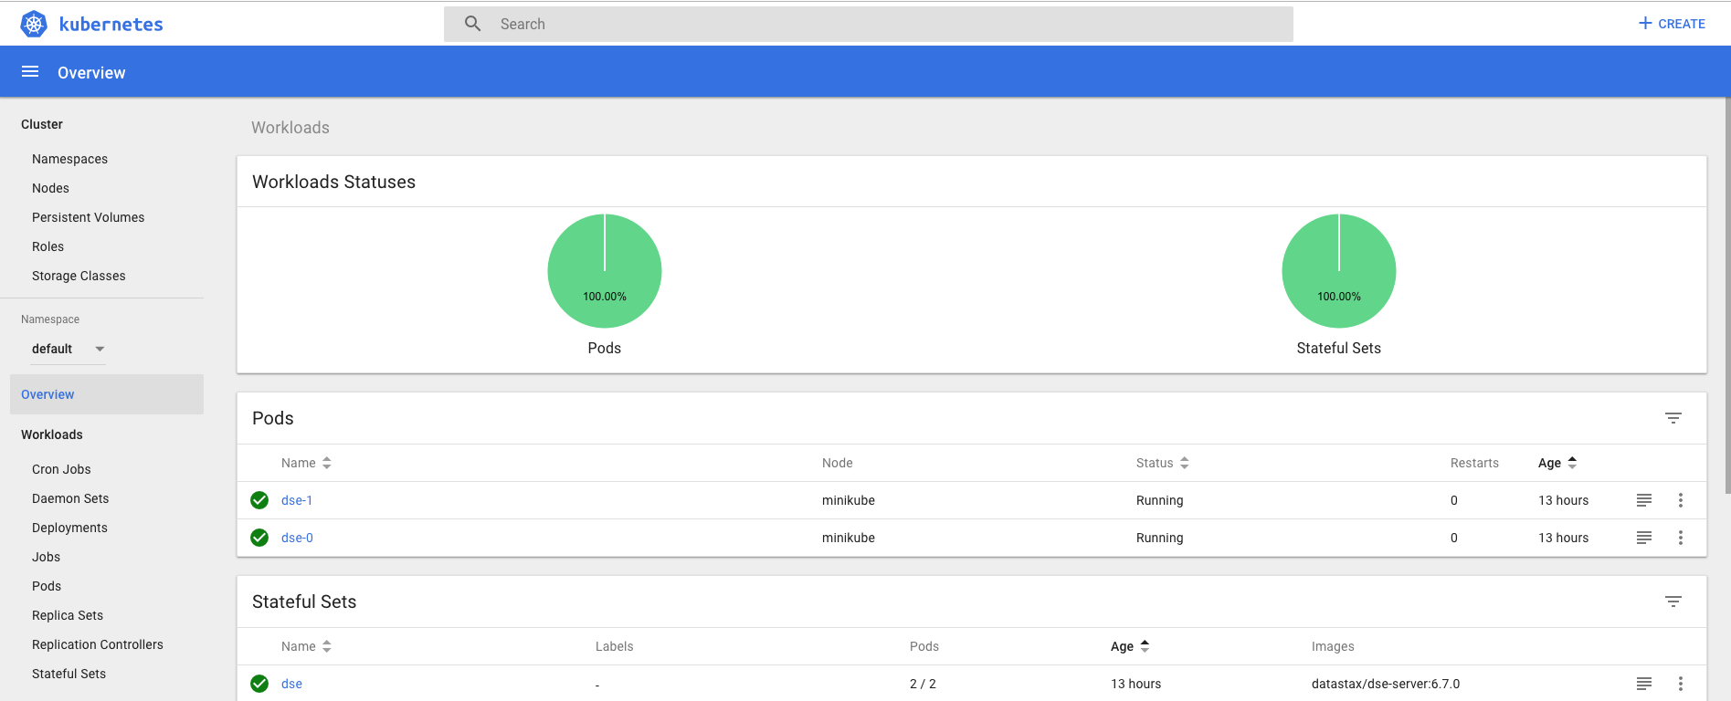
The Kubernetes Dashboard
Kubernetes Dashboard is a general purpose, web-based UI for Kubernetes clusters. It allows users to manage applications running in the cluster and troubleshoot them, as well as manage the cluster itself.

Slide 33
Allow Access to your Dashboard from Outside the Cluster
Run minikube dashboard and once it tries to connect to browser ctl + c
You will want to access your dashboard from a machine running outside of your OpenStack cluster. To do this you will need to do the following
Edit the kubernetes-dashboard service.
kubectl -n kube-system edit service kubernetes-dashboard
You should see yaml representation of the service in VI. Change type: ClusterIP to type: NodePort and save file.

Slide 34
apiVersion: v1 ... name: kubernetes-dashboard namespace: kube-system resourceVersion: "343478" selfLink: /api/v1/namespaces/kube-system/services/kubernetes-dashboard-head uid: 8e48f478-993d-11e7-87e0-901b0e532516 spec: clusterIP: 10.100.124.90 externalTrafficPolicy: Cluster ports: - port: 443 protocol: TCP targetPort: 8443 selector: k8s-app: kubernetes-dashboard sessionAffinity: None type: ClusterIP <--- Change to NodePort status: loadBalancer: {}

Slide 35
Allow Access to your Dashboard from Outside the Cluster continued
Next we need to check the port on which the Dashboard was exposed.
kubectl -n kube-system get service kubernetes-dashboard
You should see output like so
NAME CLUSTER-IP EXTERNAL-IP PORT(S) AGE kubernetes-dashboard 10.100.124.90 <nodes> 80:32609/TCP 21h In this example Dashboard has been exposed on port 32609 (HTTP).
Notes:
To find the node your Dashboard is running on run the following command.
kubectl get pods --all-namespaces -o wide | grep dashboard | awk '{print $8}'
Now you can access it from your browser at: https://node-ip:nodePort

Slide 36
Logging Into your Dashboard
Open a browser and visit
https://<k8’s_masters_ipaddress>:<port_from_previous_step>

Slide 37
Deploy a two node DSE cluster
I have put together a deployment yaml that will allow deployment of multiple DSE nodes on minikube
Get the yaml
wget --quiet https://raw.githubusercontent.com/roberd13/Support-Summit2019/master/dse-kubernetes.yaml -O dse-kubernetes.yaml
Deploy the Yaml
kubectl apply -f dse-kubernetes.yaml

Slide 38
Deploy a two node DSE cluster continued
It will take a few minutes for the nodes to come up
To check the status run the below command
kubectl get all
To run DSE commands against a container, you would run kubctl exec -it <container_name> <command>
For example to get a cql shell
kubectl exec -it dse-0 cqlsh

Slide 39
Scale the cluster
Modify the dse-kubernetes.yaml and change the number of replicas to 3
Deploy the changes
kubectl apply -f dse-kubernetes.yaml
Check the status of the cluster
kubectl exec -it dse-0 nodetool status
Destroy the cluster
kubectl delete -f dse-kubernetes.yaml

Slide 40
Install Helm and Tiller on the Kubernetes Master
As root, download helm and install it
curl https://raw.githubusercontent.com/kubernetes/helm/master/scripts/get > get_helm.sh
chmod 700 get_helm.sh
./get_helm.sh
Install Socat
apt install -y socat
Initialize helm which also installs Tiller. It will discover your Kubernetes clusters by reading $KUBECONFIG and using the default context.
helm init

Slide 41
Deploy a DSE cluster using Ryans Helm Chart
Clone https://github.com/riptano/support_performance/tree/master/charts/datastax-dse
For easier access I have added it as a tarball you can download
wget -L https://raw.githubusercontent.com/roberd13/Support-Summit2019/master/datastax-dse.tar.gz -O datastax-dse.tar.gz

Slide 42
Deploying with Helm
The Basic syntax
helm install chart
But we are not basic are we?
Lets deploy with changing some configurations.
The default configuration will deploy a 2 node DSE cluster running 6.0.4 with an 8GB heap 12GB Memory allocated to the container and 4 CPUS.
You can find these values along with others you can change in the values.yaml.
You can also see these values in the README.md
Notes:
you can pass namespace and release

Slide 43
Deploying With Helm Continued
We can change these values by editing the values.yaml or we can poke them in.
Let's take a look at poking them in
We want to deploy a single node of DSE 6.7.1 with a heap size of 2GB, container memory of 4GB and 1CPU. We will do this by passing --set option using a comma separated list of values.
helm install --namespace "dse" -n "dse" --set cassandra.replicas=1,image.tag=6.7.1,cassandra.jvm.heap_size="2G",resources.mem="4G",resources.cpu="1000m" datastax-dse

Slide 44
Deploying With Helm Continued
Now that we have a single node running, and you realized 1 node was not enough. Now we want to Scale by adding 2 nodes with the same configs. To do this we will use helm upgrade.
We need to pass the values previously poked otherwise we will use the default values
helm upgrade --set cassandra.replicas=3,image.tag=6.7.1,cassandra.jvm.heap_size="2G",resources.mem="4G",resources.cpu="1000m" dse datastax-dse

Slide 45
Destroy your cluster
When you are ready to delete your cluster you use helm delete
helm delete --purge dse
If you no longer want the data in the persistent volumes, you will need to delete your PVC’s and PV’s
This can be done via the Dashboard or with kubectl. If you deployed with a namespace other than default you will need to pass -n <namespace>
kubectl delete pvc <pvc>
kubectl delete pv <pv>
kubectl -n <namespace> options

Slide 46
Q&A

